Slide 1
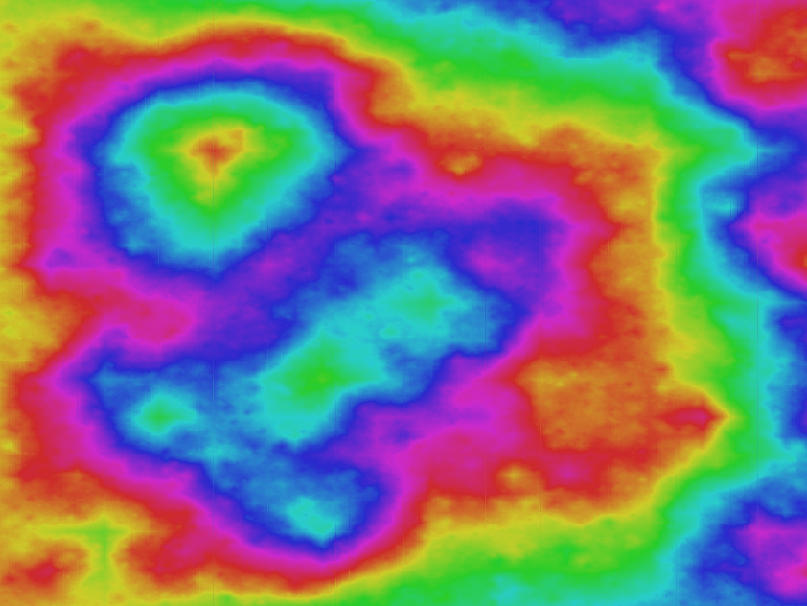
Recursion II
Fundamentals of Computer Science

Slide 2
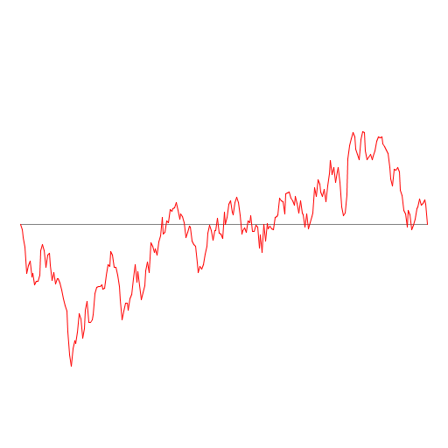
Outline
Recursion
  A method calling itself
    A new way of thinking about a problem
    A powerful programming paradigm
Examples:
  Last time:
    Factorial, binary search, H-tree, Fibonacci
  Today:
    Greatest Common Divisor (GCD)
    Brownian Motion
    Sorting

Slide 3
Recursion Walkthrough
examples
public class RecursiveMystery
{
public static void mystery(int n)
{
System.out.println(n);
if (n <= 0)
return; //Pop
mystery(n - 1); //Push
mystery(n - 2); //Push
} //Pop
public static void main(String[] args)
{
mystery(3); //Push
} //Pop
}
Call Stack | n

Slide 4
Recursion Walkthrough
examples
public class RecursiveMystery
{
public static void mystery(int n)
{
System.out.println(n);
if (n <= 0)
return; //Pop
mystery(n - 1); //Push
mystery(n - 2); //Push
} //Pop
public static void main(String[] args)
{
mystery(3); //Push
} //Pop
}
Call Stack | n
 | 3
mystery(3)

Slide 5
Recursion Walkthrough
examples
public class RecursiveMystery
{
public static void mystery(int n)
{
System.out.println(n);
if (n <= 0)
return; //Pop
mystery(n - 1); //Push
mystery(n - 2); //Push
} //Pop
public static void main(String[] args)
{
mystery(3); //Push
} //Pop
}
Call Stack | n
 | 2
mystery(3-1) | 3
mystery(3)
3

Slide 6
Recursion Walkthrough
examples
public class RecursiveMystery
{
public static void mystery(int n)
{
System.out.println(n);
if (n <= 0)
return; //Pop
mystery(n - 1); //Push
mystery(n - 2); //Push
} //Pop
public static void main(String[] args)
{
mystery(3); //Push
} //Pop
}
Call Stack | n
 | 1
mystery(2-1) | 2
mystery(3-1) | 3
mystery(3)
3
2

Slide 7
Recursion Walkthrough
examples
public class RecursiveMystery
{
public static void mystery(int n)
{
System.out.println(n);
if (n <= 0)
return; //Pop
mystery(n - 1); //Push
mystery(n - 2); //Push
} //Pop
public static void main(String[] args)
{
mystery(3); //Push
} //Pop
}
Call Stack | n
 | 0
mystery(1-1) | 1
mystery(2-1) | 2
mystery(3-1) | 3
mystery(3)
3
2
1

Slide 8
Recursion Walkthrough
examples
public class RecursiveMystery
{
public static void mystery(int n)
{
System.out.println(n);
if (n <= 0)
return; //Pop
mystery(n - 1); //Push
mystery(n - 2); //Push
} //Pop
public static void main(String[] args)
{
mystery(3); //Push
} //Pop
}
Call Stack | n
 | 0
mystery(1-1) | 1
mystery(2-1) | 2
mystery(3-1) | 3
mystery(3)
3
2
1
0

Slide 9
Recursion Walkthrough
examples
public class RecursiveMystery
{
public static void mystery(int n)
{
System.out.println(n);
if (n <= 0)
return; //Pop
mystery(n - 1); //Push
mystery(n - 2); //Push
} //Pop
public static void main(String[] args)
{
mystery(3); //Push
} //Pop
}
Call Stack | n
 | 1
mystery(2-1) | 2
mystery(3-1) | 3
mystery(3)
3
2
1
0

Slide 10
Recursion Walkthrough
examples
public class RecursiveMystery
{
public static void mystery(int n)
{
System.out.println(n);
if (n <= 0)
return; //Pop
mystery(n - 1); //Push
mystery(n - 2); //Push
} //Pop
public static void main(String[] args)
{
mystery(3); //Push
} //Pop
}
Call Stack | n
 | -1
mystery(1-2) | 1
mystery(2-1) | 2
mystery(3-1) | 3
mystery(3)
3
2
1
0

Slide 11
Recursion Walkthrough
examples
public class RecursiveMystery
{
public static void mystery(int n)
{
System.out.println(n);
if (n <= 0)
return; //Pop
mystery(n - 1); //Push
mystery(n - 2); //Push
} //Pop
public static void main(String[] args)
{
mystery(3); //Push
} //Pop
}
Call Stack | n
 | -1
mystery(1-2) | 1
mystery(2-1) | 2
mystery(3-1) | 3
mystery(3)
3
2
1
0

Slide 12
Recursion Walkthrough
examples
public class RecursiveMystery
{
public static void mystery(int n)
{
System.out.println(n);
if (n <= 0)
return; //Pop
mystery(n - 1); //Push
mystery(n - 2); //Push
} //Pop
public static void main(String[] args)
{
mystery(3); //Push
} //Pop
}
Call Stack | n
 | 1
mystery(2-1) | 2
mystery(3-1) | 3
mystery(3)
3
2
1
0
-1

Slide 13
Recursion Walkthrough
examples
public class RecursiveMystery
{
public static void mystery(int n)
{
System.out.println(n);
if (n <= 0)
return; //Pop
mystery(n - 1); //Push
mystery(n - 2); //Push
} //Pop
public static void main(String[] args)
{
mystery(3); //Push
} //Pop
}
Call Stack | n
 | 2
mystery(3-1) | 3
mystery(3)
3
2
1
0
-1

Slide 14
Recursion Walkthrough
examples
public class RecursiveMystery
{
public static void mystery(int n)
{
System.out.println(n);
if (n <= 0)
return; //Pop
mystery(n - 1); //Push
mystery(n - 2); //Push
} //Pop
public static void main(String[] args)
{
mystery(3); //Push
} //Pop
}
Call Stack | n
 | 0
mystery(2-2) | 2
mystery(3-1) | 3
mystery(3)
3
2
1
0
-1

Slide 15
Recursion Walkthrough
examples
public class RecursiveMystery
{
public static void mystery(int n)
{
System.out.println(n);
if (n <= 0)
return; //Pop
mystery(n - 1); //Push
mystery(n - 2); //Push
} //Pop
public static void main(String[] args)
{
mystery(3); //Push
} //Pop
}
Call Stack | n
 | 2
mystery(3-1) | 3
mystery(3)
3
2
1
0
-1
0

Slide 16
Recursion Walkthrough
examples
public class RecursiveMystery
{
public static void mystery(int n)
{
System.out.println(n);
if (n <= 0)
return; //Pop
mystery(n - 1); //Push
mystery(n - 2); //Push
} //Pop
public static void main(String[] args)
{
mystery(3); //Push
} //Pop
}
Call Stack | n
 | 3
mystery(3)
3
2
1
0
-1
0

Slide 17
Recursion Walkthrough
examples
public class RecursiveMystery
{
public static void mystery(int n)
{
System.out.println(n);
if (n <= 0)
return; //Pop
mystery(n - 1); //Push
mystery(n - 2); //Push
} //Pop
public static void main(String[] args)
{
mystery(3); //Push
} //Pop
}
Call Stack | n
 | 1
mystery(3-2) | 3
mystery(3)
3
2
1
0
-1
0

Slide 18
Recursion Walkthrough
examples
public class RecursiveMystery
{
public static void mystery(int n)
{
System.out.println(n);
if (n <= 0)
return; //Pop
mystery(n - 1); //Push
mystery(n - 2); //Push
} //Pop
public static void main(String[] args)
{
mystery(3); //Push
} //Pop
}
Call Stack | n
 | 0
mystery(1-1) | 1
mystery(3-2) | 3
mystery(3)
3
2
1
0
-1
0
1

Slide 19
Recursion Walkthrough
examples
public class RecursiveMystery
{
public static void mystery(int n)
{
System.out.println(n);
if (n <= 0)
return; //Pop
mystery(n - 1); //Push
mystery(n - 2); //Push
} //Pop
public static void main(String[] args)
{
mystery(3); //Push
} //Pop
}
Call Stack | n
 | 1
mystery(3-2) | 3
mystery(3)
3
2
1
0
-1
0
1
0

Slide 20
Recursion Walkthrough
examples
public class RecursiveMystery
{
public static void mystery(int n)
{
System.out.println(n);
if (n <= 0)
return; //Pop
mystery(n - 1); //Push
mystery(n - 2); //Push
} //Pop
public static void main(String[] args)
{
mystery(3); //Push
} //Pop
}
Call Stack | n
 | -1
mystery(1-2) | 1
mystery(3-2) | 3
mystery(3)
3
2
1
0
-1
0
1
0

Slide 21
Recursion Walkthrough
examples
public class RecursiveMystery
{
public static void mystery(int n)
{
System.out.println(n);
if (n <= 0)
return; //Pop
mystery(n - 1); //Push
mystery(n - 2); //Push
} //Pop
public static void main(String[] args)
{
mystery(3); //Push
} //Pop
}
Call Stack | n
 | 1
mystery(3-2) | 3
mystery(3)
3
2
1
0
-1
0
1
0
-1

Slide 22
Recursion Walkthrough
examples
public class RecursiveMystery
{
public static void mystery(int n)
{
System.out.println(n);
if (n <= 0)
return; //Pop
mystery(n - 1); //Push
mystery(n - 2); //Push
} //Pop
public static void main(String[] args)
{
mystery(3); //Push
} //Pop
}
Call Stack | n
 | 3
mystery(3)
3
2
1
0
-1
0
1
0
-1

Slide 23
Recursion Walkthrough
examples
public class RecursiveMystery
{
public static void mystery(int n)
{
System.out.println(n);
if (n <= 0)
return; //Pop
mystery(n - 1); //Push
mystery(n - 2); //Push
} //Pop
public static void main(String[] args)
{
mystery(3); //Push
} //Pop
}
Call Stack | n
3
2
1
0
-1
0
1
0
-1

Slide 24
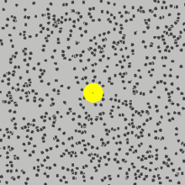
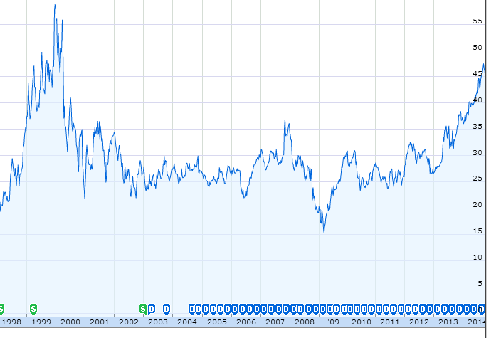
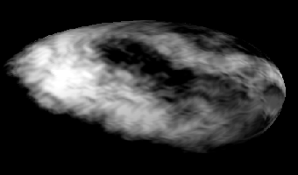
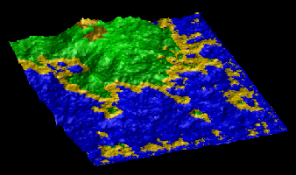
Brownian Motion
examples
Models many natural and artificial phenomenon
  Motion of pollen grains in water
  Price of stocks
  Rugged shapes of mountains and clouds

Slide 25
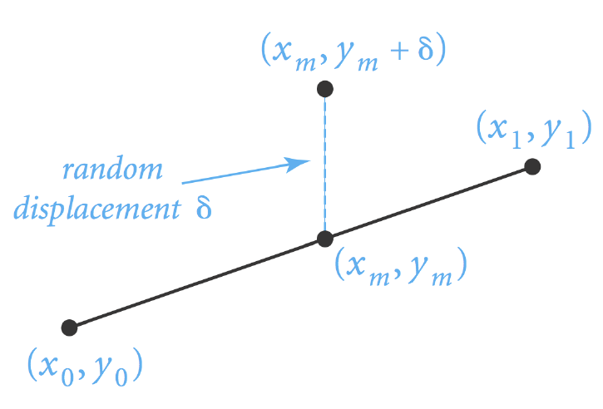
Simulating Brownian Motion
examples
Midpoint displacement method:
  Track interval (x₀, y₀) to (x₁, y₁)
  Choose δ displacement randomly from Gaussian
  Divide in half, x_{m}= (x₀+x₁)/2 and y_{m} = (y₀+y₁)/2 + δ
  Recur on the left and right intervals

Slide 26

Recursive Midpoint Displacement Algorithm
void curve(double x0, double y0, double x1, double y1, double var)
{
if (x1 - x0 < .005)
{
StdDraw.line(x0, y0, x1, y1);
return;
}
double xm = (x0 + x1) / 2.0;
double ym = (y0 + y1) / 2.0;
ym = ym + StdRandom.gaussian(0, Math.sqrt(var));
curve(x0, y0, xm, ym, var / 2.0);
curve(xm, ym, x1, y1, var / 2.0);
}
base case
reduction step

Slide 27
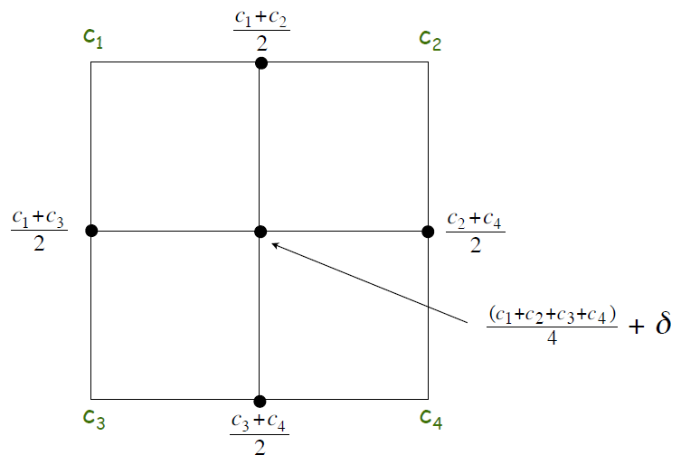
Plasma Cloud
examples
Same idea, but in 2D
  Each corner of square has some color value
  Divide into four sub-squares
  New corners: avg of original corners, or all 4 + random
  Recur on four sub-squares

Slide 28
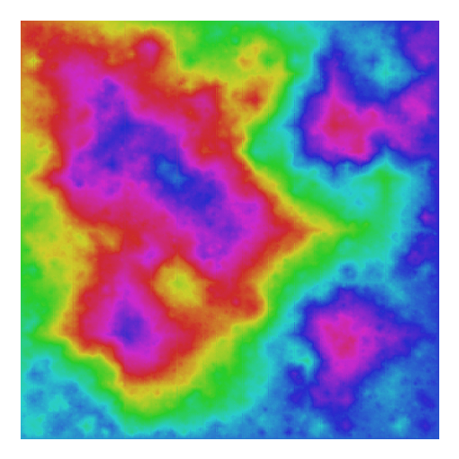
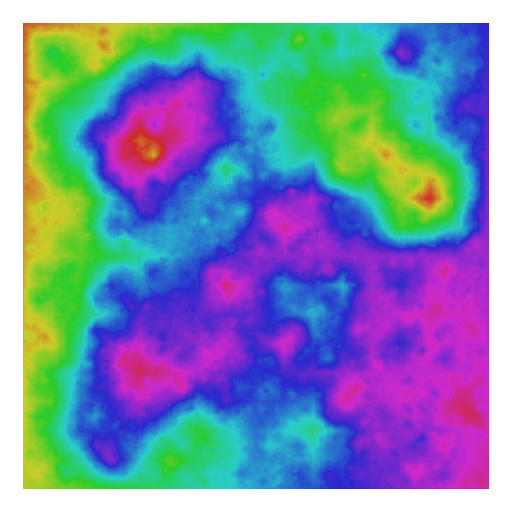
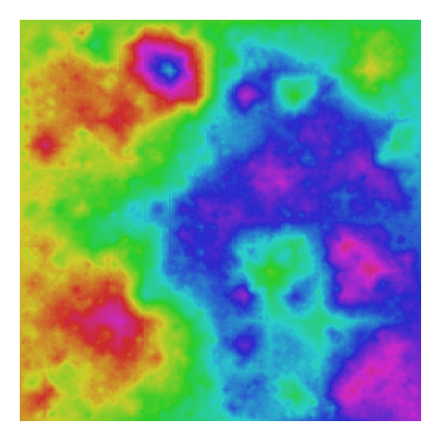
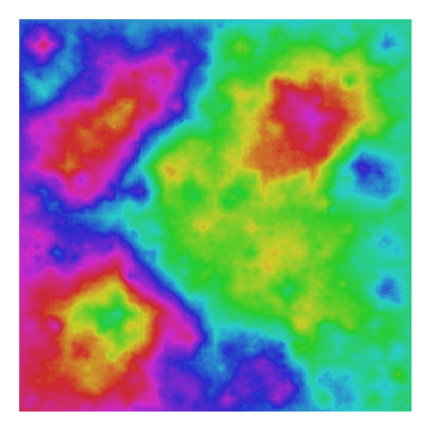
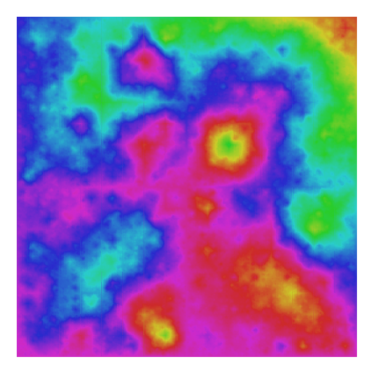
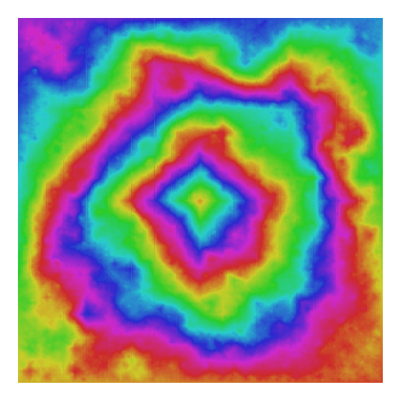

Slide 29

Brownian Landscape

Slide 30
Divide and Conquer
examples
Divide and conquer paradigm
  Break big problem into small sub-problems
  Solve sub-problems recursively
  Combine results
Used to solve many important problems
  Sorting things, mergesort: O(N log N)
  Parsing programming languages
  Discrete FFT, signal processing
  Multiplying large numbers
  Traversing multiply linked structures (stay tuned)
“Divide et impera. Vendi, vidi, vici.”
-Julius Caesar
Notes:
"Divide and conquer", Caesar's other famous quote "I came, I saw, I conquered"
Divide-and-conquer idea dates back to Julius Caesar . (100 BCE - 44 BCE).
Favorite war tactic was to divide an opposing army in two halves, and then assault one half with his entire force.

Slide 31

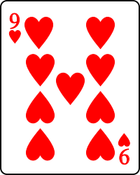
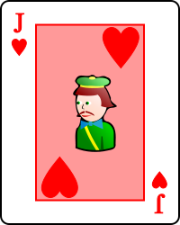
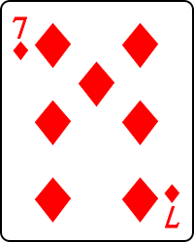
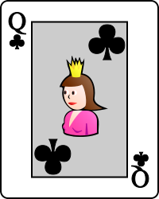
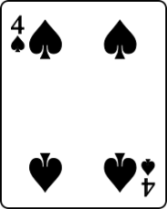
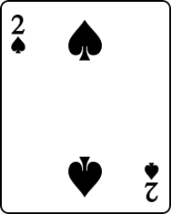
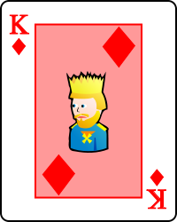
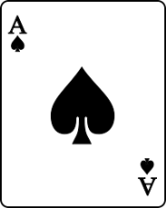
Divide and Conquer: Sorting
examples
Goal: Sort by number, ignore suit, aces high
Approach
Split in half (or as close as possible)
Give each half to somebody to sort
Take two halves and merge together
Unsorted pile #1
Unsorted pile #2

Slide 32
examples
Approach
Split in half (or as close as possible)
Give each half to somebody to sort
Take two halves and merge together
Sorted pile #1
Sorted pile #2
Merging
Take card from whichever pile has lowest card

Slide 33
examples
Approach
Split in half (or as close as possible)
Give each half to somebody to sort
Take two halves and merge together
Sorted pile #1
Sorted pile #2

Slide 34
examples
Approach
Split in half (or as close as possible)
Give each half to somebody to sort
Take two halves and merge together
Sorted pile #1
Sorted pile #2

Slide 35
examples
Approach
Split in half (or as close as possible)
Give each half to somebody to sort
Take two halves and merge together
Sorted pile #1
Sorted pile #2

Slide 36
examples
Approach
Split in half (or as close as possible)
Give each half to somebody to sort
Take two halves and merge together
Sorted pile #1
Sorted pile #2

Slide 37
examples
Approach
Split in half (or as close as possible)
Give each half to somebody to sort
Take two halves and merge together
Sorted pile #1
Sorted pile #2

Slide 38
examples
Approach
Split in half (or as close as possible)
Give each half to somebody to sort
Take two halves and merge together
Sorted pile #1
Sorted pile #2

Slide 39
examples
Approach
Split in half (or as close as possible)
Give each half to somebody to sort
Take two halves and merge together
Sorted pile #1
Sorted pile #2

Slide 40
examples
Approach
Split in half (or as close as possible)
Give each half to somebody to sort
Take two halves and merge together
Sorted pile #1
Sorted pile #2

Slide 41
examples
Approach
Split in half (or as close as possible)
Give each half to somebody to sort
Take two halves and merge together
Sorted pile #1
Sorted pile #2
How many operations to do the merge?
Linear in the number of cards, O(N)
But how did pile 1 and 2 get sorted?
Recursively of course!
Split each pile into two halves, give to different people to sort.

Slide 42
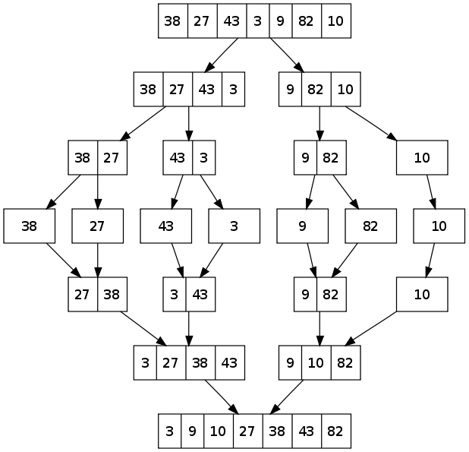
examples
How many split levels?
O(log₂N)
How many merge levels?
O(log₂N)
Operations per level?
O(N)
Total operations?
O(Nlog₂N)

Slide 43

Summary
Recursion
  A method calling itself:
    Sometimes just once, e.g. binary search
    Sometimes twice, e.g. mergesort
    Sometimes multiple times, e.g. H-tree
  All good recursion must come to an end:
    Base case that does NOT call itself recursively
  A powerful tool in computer science:
    Allows elegant and easy to understand algorithms
    (Once you get your head around it)

